Slide 1
Programming Fundamentals
Week – 01
by Abeeha Sattar

Slide 2
Multi-Dimensional Arrays
We’ve done 1-D and 2-D arrays so far.
By adding another [] to our array declaration, we can add more dimensions to our array.
int array[3][3][3]; //will make a 3-D integer array
char myStrs[3][3][3][3]; //will make a 4-D character array.

Slide 3
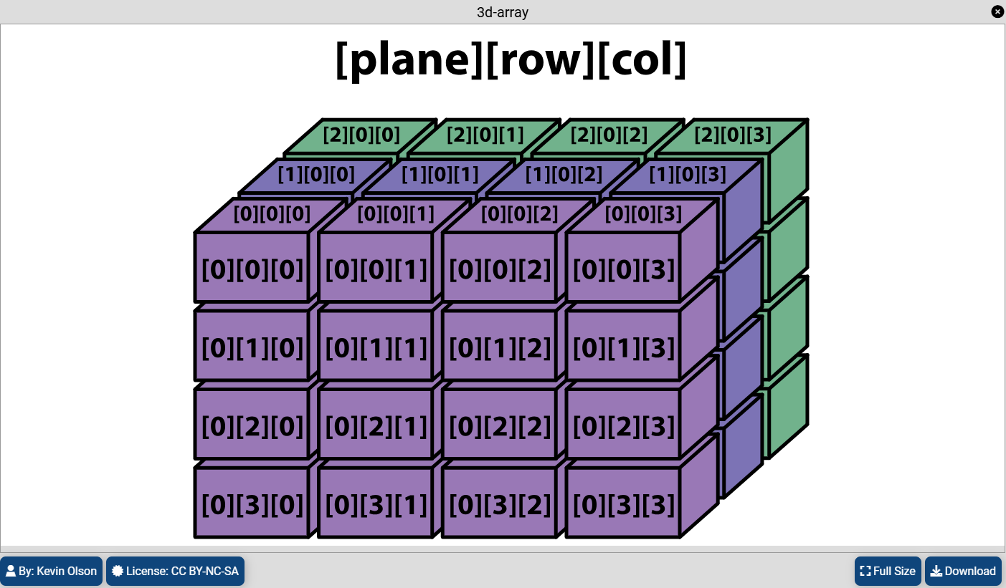
Visualizing 3D - Arrays
https://kevinsguides.com/guides/code/java/javaintro/ch11-2d-3d-arrays/
You can read the guide if you want. The code is in java however, you can ask ChatGPT or any other tool to convert it into C code.

Slide 4
Scope of a Variable
A variable can be:
Global
If a variable exists outside of a function, then it is a global variable.
This means that you can access it anywhere.
Local
If a variable exists within a code block, then the variable is local to that code block.
You cannot access that variable outside that code block.
Code Blocks:
For loop is a code block.
The if-block is a code block.
The else-block is a code block.
A function is a code block.
Anything within curly brackets is a code block.

Slide 5
An Example (see the .c on GitHub for a commented version)
int globalInt = 0;
char globalChar = 'c';
int main() {
int localInt = 10;
char localChar = 'e';
if(localInt == 10) {
int localToIf = 20;
localToIf = localInt;
} else {
int localToElse = 30;
localToElse = localInt;
localToElse = globalInt;
localToElse = localToIf;
}
for (int forVar = 0; forVar < 5; forVar++){
forVar = localInt;
}
while (globalInt) {
int whileVar = globalInt;
whileVar = localInt;
localToIf = 10;
localToElse = 10;
forVar = 10;
break;
}
do {
int doVar = globalInt;
doVar = localInt;
localToIf = 10;
localToElse = 10;
forVar = 10;
whileVar = 10;
break;
} while(globalVar);
return 0;
}

Slide 6
Functions
It is a block of code, which contains a set of instructions to perform a specific task.
A function may accept inputs/arguments/parameters.
A function may return an output/return values.
Syntax to define a function:
returnType functionName ( arguments list ) {
// function body
}

Slide 7
Let’s have a look at the main function
The function name
The argument
The return type
int main (void) {
return 0;
}
The function body
Goes within the curly brackets
Everything inside this box is also known as the “signature” of that function.
The value being returned

Slide 8

printf and scanf are functions…
Whenever you write:
printf(“something”);
scanf(“%d”, &i);
You’re actually calling the pre-defined functions present in the stdio.h library.
Do you remember what printf returns?
What does scanf return?
What are the arguments here?

Slide 9
What can you pass to a function when calling it?
You can send it a constant value, like 1, 2, ‘a’, etc., based on what type of argument it accepts.
You can also send it variables of the corresponding data types.
It can also be a combination of the above two things.
For example, consider this function:
void myFunction(int a, char c) {
//do something
}
int main(){
char ch = ‘c’;
int a = 10;
myFunction(55, ‘R’);
myFunction(a, ch);
myFunction(44, ch);
myFunction(a, ‘E’);
}

Slide 10
Let’s make some custom functions of our own! Also, call these functions from the main function.
A function that displays “Hello World”, doesn’t accept or return anything.
A function that accepts one integer and return true if it is even, otherwise it returns false.
A function that accepts a character, and returns ‘V’ if the character is a vowel, other it returns ‘C’ if the character is a consonant.
A function that accepts two float values and returns the larger value.
A function that accepts two integers and finds out their sum and returns it.
A function that accepts two integers and one character. The if the character is ‘+’, ‘-’, ‘/’ or ‘*’ then it performs that operation on the integers and returns the result. Otherwise, it says ‘invalid operation’

Slide 11
Things start to get a bit complicated here…
What happens if I want to pass an array to a function?
What should I pass as an argument?
Before we go there, let’s discuss the concept of:
Pass by value
Pass by reference

Slide 12
Passing an argument by value
Basically, what we have been doing so far. In the previous example with “myFunction”, during the function call, values of the variables x and ch are being passed.
void myFunction(int a, char c) {
//do something
}
int main(){
char ch = ‘c’;
int x = 10;
myFunction(x, ch);
}

Slide 13
Passing an Argument by Value
Copy of argument passed to function
Changes in function do not affect the original variables
Use when the function does not need to modify the argument
Avoids accidental changes

Slide 14
Passing an argument by reference
Here’s where pointers come in to start haunting you again.
But don’t worry, it’s not as scary as you may think.
Let’s have a look.
void function( int *p) {
//this change will reflect on ‘x’
*p = 20;
}
int main(){
int x = 10;
//calling the function
//passing the address of x
function(&x);
}

Slide 15
Let’s visualize the example
x:
When we call ‘function(&x);’ we’re sending address of x to the declaration int *p
So basically, “int* p = &x” is going on in the background.
p:
So, when we say *p, we have something like “*(100)” being calculated.
And “*p = 20;” means: go to *(100) and write 20 there.
10
Let’s say address of x is 100
100

Slide 16
Passing an argument by reference
Passes original argument
Changes in function effect original
Only used with trusted functions

Slide 17
Back to the Original Question
How do we pass arrays as arguments?
There’s two ways to send an array as an argument:
Passing the array by reference
… or the easy way!

Slide 18
Let’s Look at the Easy Way first!
void display1D(int arr[], int size) {
for (int i = 0; i< size; i++) {
printf("%d ", arr[i]);
}
printf("\n");
}
int main() {
int arr1D[] = {11, 22, 33, 44, 55, 66, 77, 88, 99, 111};
int arr1D_size5[5] = {1, 2, 3, 4, 5};
display1D(arr1D, sizeof(arr1D)/4);
display1D(arr1D_size5, sizeof(arr1D_size5)/4);
}

Slide 19
And now, the pointers…
It’s actually not that difficult :D
void display1D(int* arr, int size) {
for (int i = 0; i< size; i++) {
printf("%d ", arr[i]);
}
printf("\n");
}
int main() {
int arr1D[] = {11, 22, 33, 44, 55, 66, 77, 88, 99, 111};
int arr1D_size5[5] = {1, 2, 3, 4, 5};
display1D(arr1D, sizeof(arr1D)/4);
display1D(arr1D_size5, sizeof(arr1D_size5)/4);
}

Slide 20
Passing 2D Arrays to Functions
void displayNames(char arr[3][3]) {
for(int i=0; i<3; i++) {
for(int j=0; j<3; j++) {
printf("%c",arr[i][j]);
}
printf("\n");
}
}
int main(){
char names[3][3] = {
{'t', 'i', 'm'},
{'t', 'o', 'm'},
{'b', 'o', 'b'}
};
displayNames(names);
}

Slide 21
Returning a 1-D Array
int arr_1d[10] = {1,2,3,4,5,6,7,8,9,0};
int* returnArray() {
return arr_1d;
}

Slide 22
Returning a 2-D Array
int arr_2d [3][3] = {
{1,0,3},
{4,0,6},
{7,0,9}
};
int* returnArray_2d_1() {
return &arr_2d[0][0];
}
int main() {
int (*arr_r2d_1)[3] = returnArray_2d_1();
for (int i = 0; i < 3; i++) {
for (int j = 0; j < 3; j++) {
printf("%d ", arr_r2d_1[i][j]);
}
printf("\n");
}
}

Slide 23
Returning a 2-D Array; The Spooky Way
int (*returnArray_2d_2())[3] {
return arr_2d;
}
//in main, call it as such:
int (*arr_r2d_2)[3] = returnArray_2d_2();
for (int i = 0; i < 3; i++) {
for (int j = 0; j < 3; j++) {
printf("%d ", arr_r2d_2[i][j]);
}
printf("\n");
}

Slide 24
Fin.

